Slide 1
Steer-by-Wire in Automobiles
DESIGN PROJECT
ANN MARY JOSEPH :14
ASWIN RAJ :20
BENSEN BERNARD :22

Slide 2
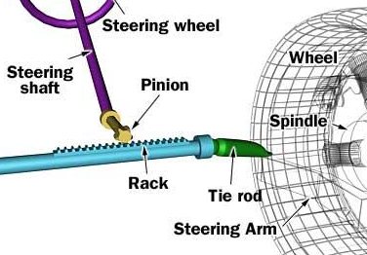
STEERING SYSTEM
Shaft
Pinion
Rack
Tie Rod
Steering arm

Slide 3
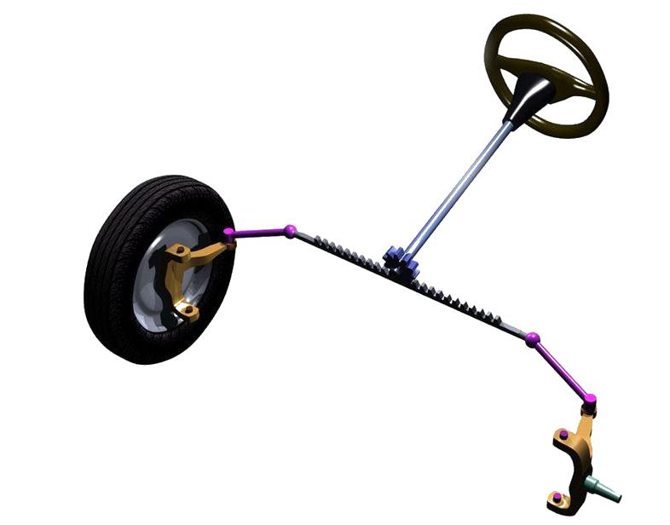
STEERING SYSTEM
Direct link from steering to rack
Additional Torque can be provided for ease of use

Slide 4
Existing Steering Methods
Manual Steering
Direct Mechanical connection
Power Steering(Mechanical assistance)
Hydraulic
Electric
Hybrid

Slide 5
Disadvantages of Steering column
More moving parts
Disturbances
Complexity
More joints
Lubrication
Fluid leaks(in case of hydraulic)
Engine Vibrations
Terrain vibrations
Torque steer phenomenon
Cannot be directly connected.

Slide 6
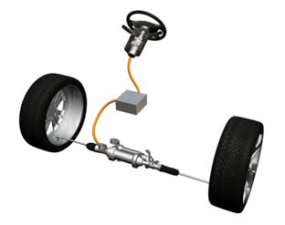
Solution
There is no direct mechanical link
Sense the input from steering
Produce output at the wheels
Steer-by-wire

Slide 7
Shaft
DIRECT STEERING SYSTEM
Steering Input
Rack Movement
Power Steering
Motor

Slide 8
Sensors
STEER-BY-WIRE
Steering Input
Control Unit
Rack Movement
Motor

Slide 9
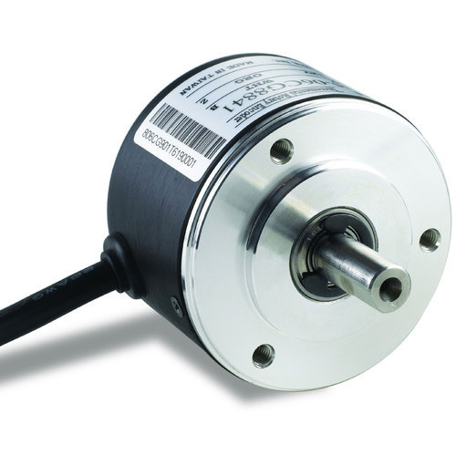
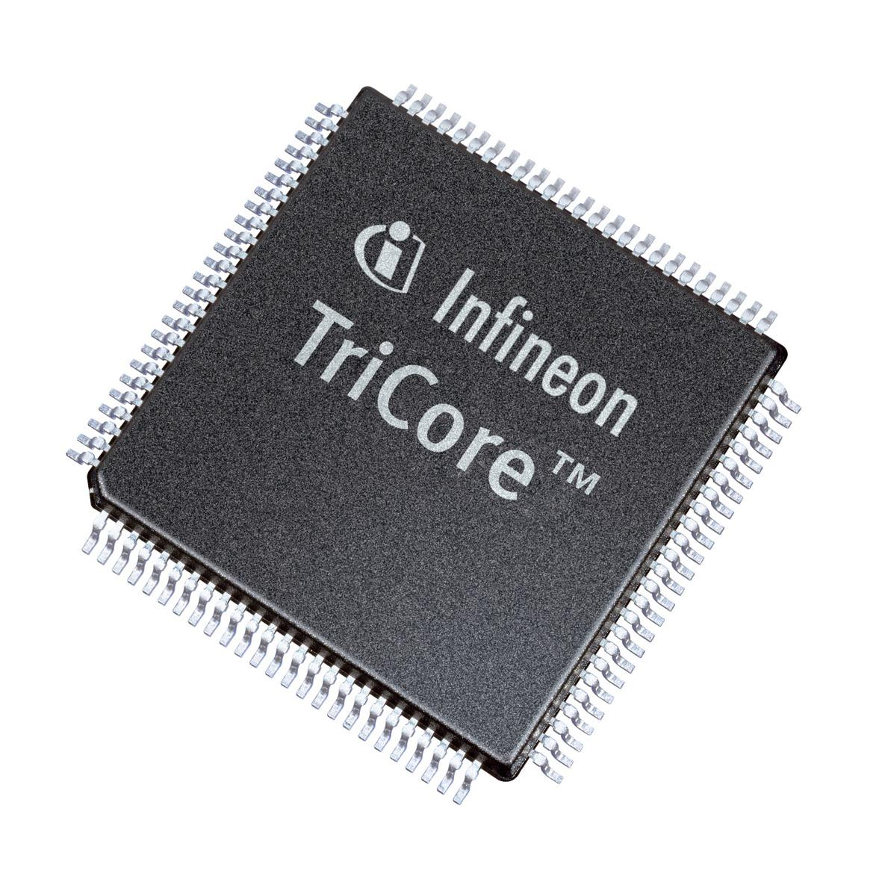
SENSORS
Sense the Angular Displacement
Connected to the shaft of Steering Wheel
MICROCONTROLLER
Control the Motor according to the input
Microcontroller Based Feedback Control

Slide 10
MOTOR
Should provide the required torque
Since Rack Movements are small, High speed are not required
Stepper motors and Brushless motors

Slide 11
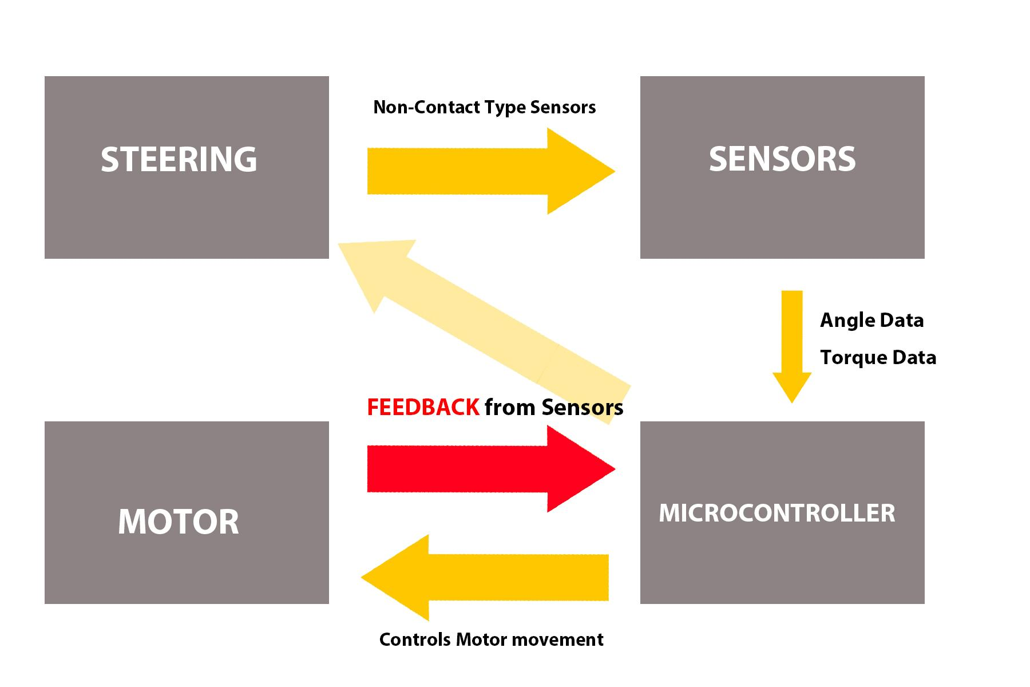
BLOCK DIAGRAM

Slide 12
ADVANTAGES
Better maneuverability
Reduce unnecessary terrain and engine vibrations
Torque steer issue is resolved to some extent
Step closer to autonomous car
Change sensitivity settings
Engine Accomodation is simpler

Slide 13
DISADVANTAGEOUS
Feedback devoid Driving Experience
No backup

Slide 14
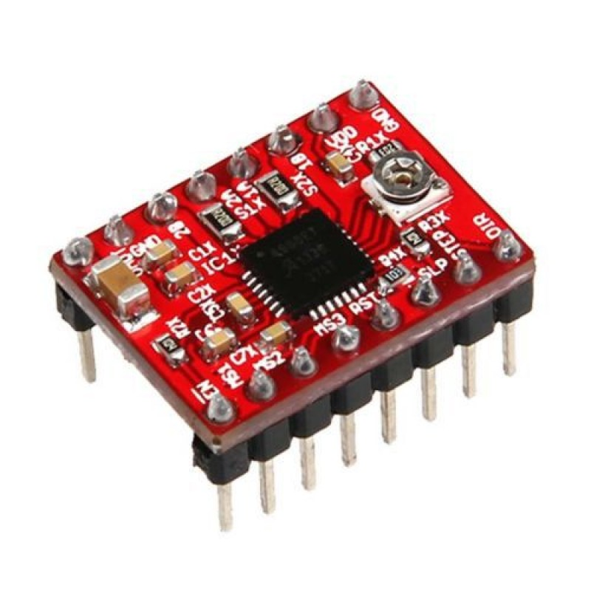
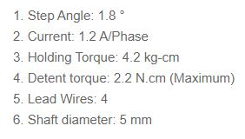
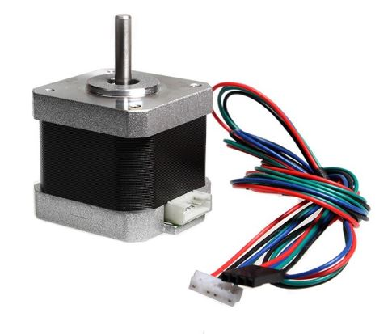
PROTOTYPE
COMPONENTS USED
MICROSTEPPING MOTOR DRIVER (A4988)
STEPPER MOTOR(NEMA 17)

Slide 15
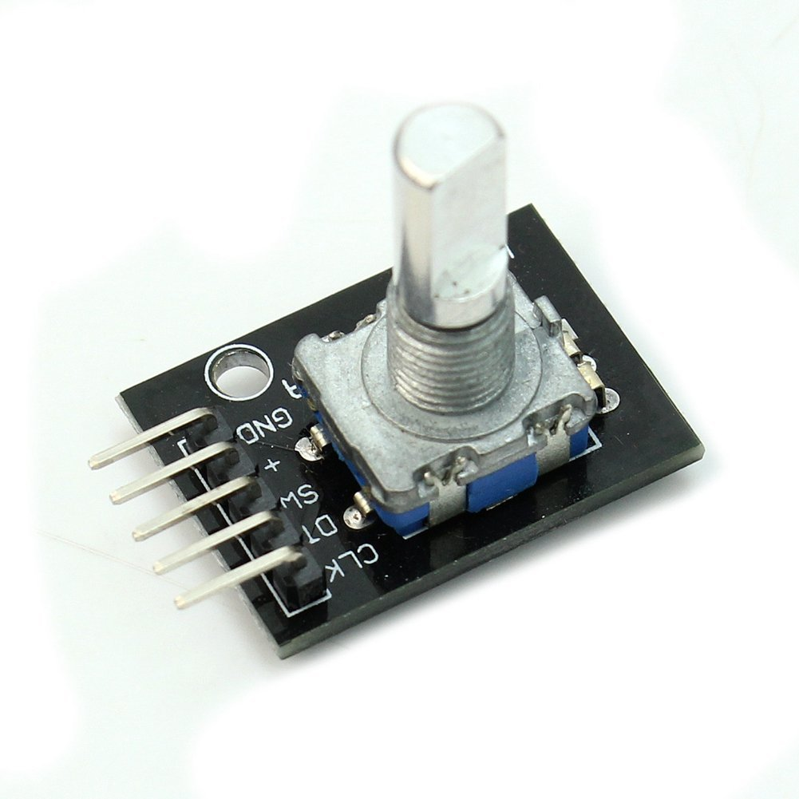
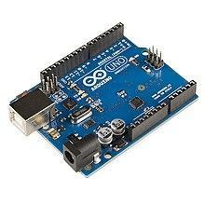
PROTOTYPE
COMPONENTS USED
ROTARY ENCODER(KY-040)
MICROCONTROLLER(ARDUINO)

Slide 16
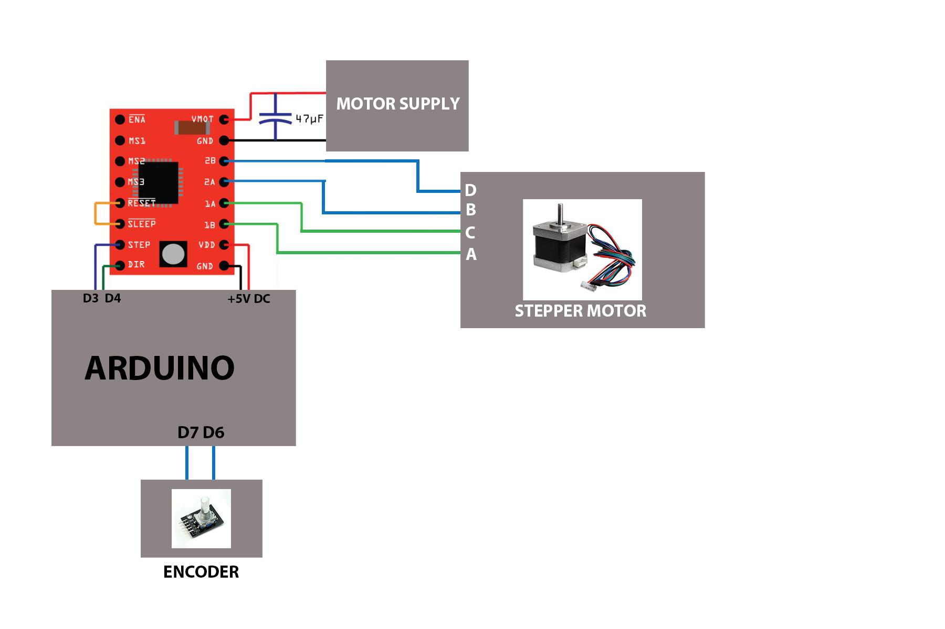
PROTOTYPE
CIRCUIT

Slide 17
PROTOTYPE
CODE
if (digitalRead(outputB) != aState) {
counter ++;
} else {
counter --;
}
}
delay(10);
aLastState = aState;
}
sensorangle=abs(counter*rs_angle);
for(int x = 0; x < sensorangle*30/90; x++) {
if counter<0;{
digitalWrite(dirPin,HIGH);
digitalWrite(stepPin,HIGH);
delayMicroseconds(10);
digitalWrite(stepPin,LOW);
delayMicroseconds(10);
}
if counter>0;{
digitalWrite(dirPin,LOW);
digitalWrite(stepPin,HIGH);
delayMicroseconds(10);
digitalWrite(stepPin,LOW);
delayMicroseconds(10);
}
}
}
const int stepPin = 3;
const int dirPin = 4;
int counter = 0;
const int outputA = 7;
const int outputB = 6;
const int aState;
const int aLastState;
const int msteps=200;
const int ms_angle=360/msteps;
const int rsteps=200;
const int rs_angle=360/rsteps;
int sensorangle;
void setup() {
pinMode(stepPin,OUTPUT);
pinMode(dirPin,OUTPUT);
pinMode (outputA,INPUT);
pinMode (outputB,INPUT);
Serial.begin (9600);
aLastState = digitalRead(outputA);
}
void loop() {
counter=0;
for(int i=0;i<10;i++);
{
aState = digitalRead(outputA);
if (aState != aLastState){

Slide 18
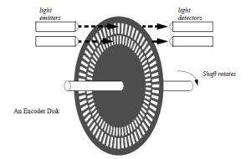
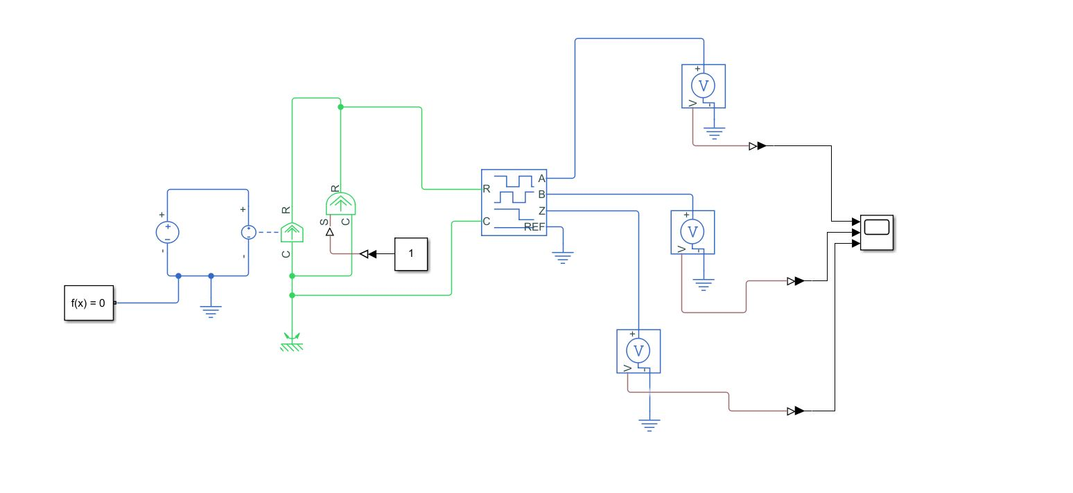
SIMULATION- INCREMENTAL ENCODER

Slide 19
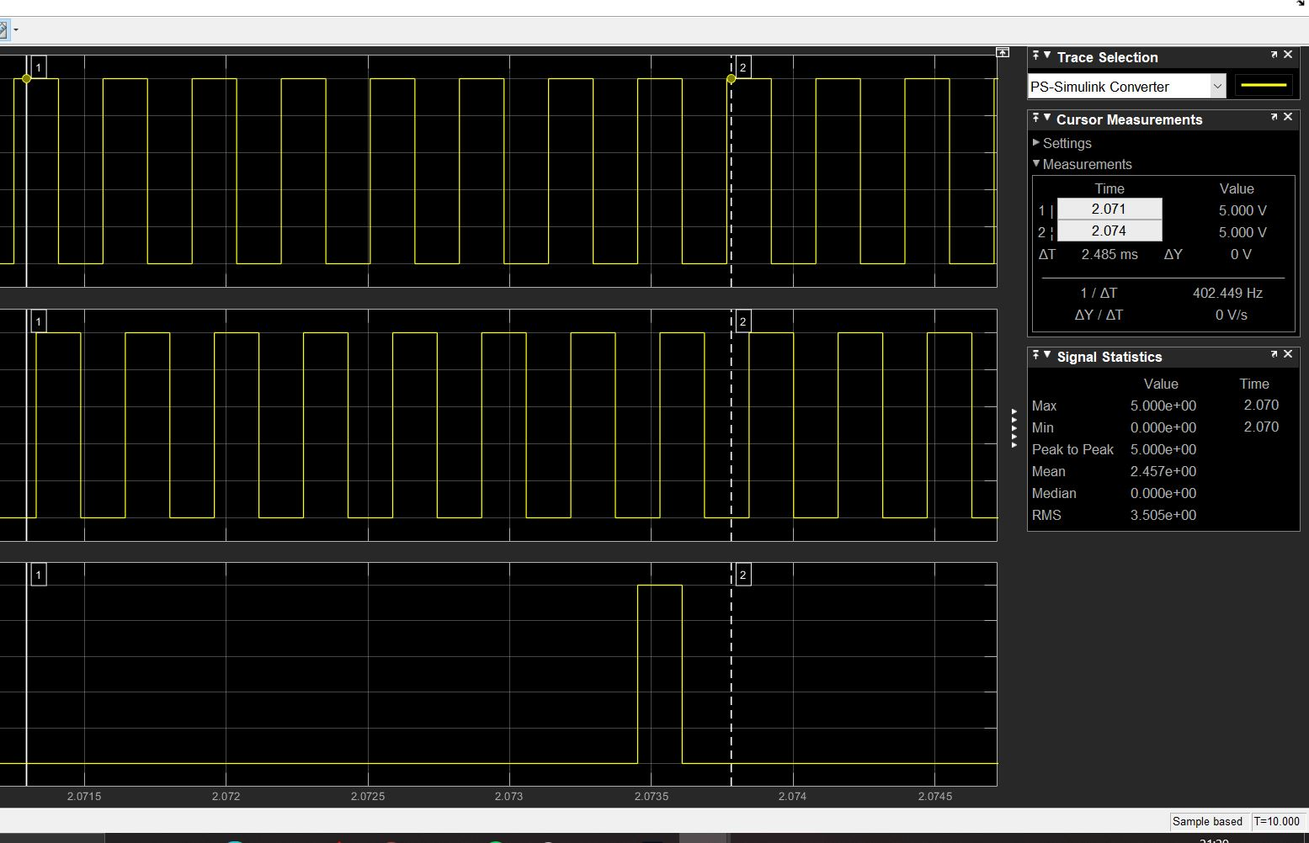
SIMULATION- INCREMENTAL ENCODER

Slide 20
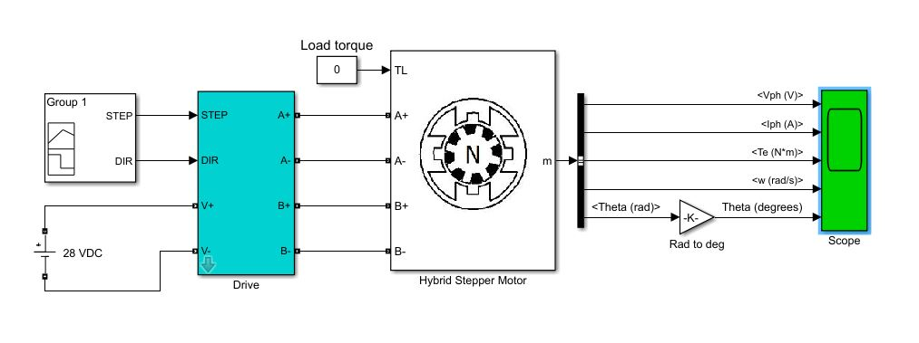
SIMULATION- STEPPER MOTOR

Slide 21
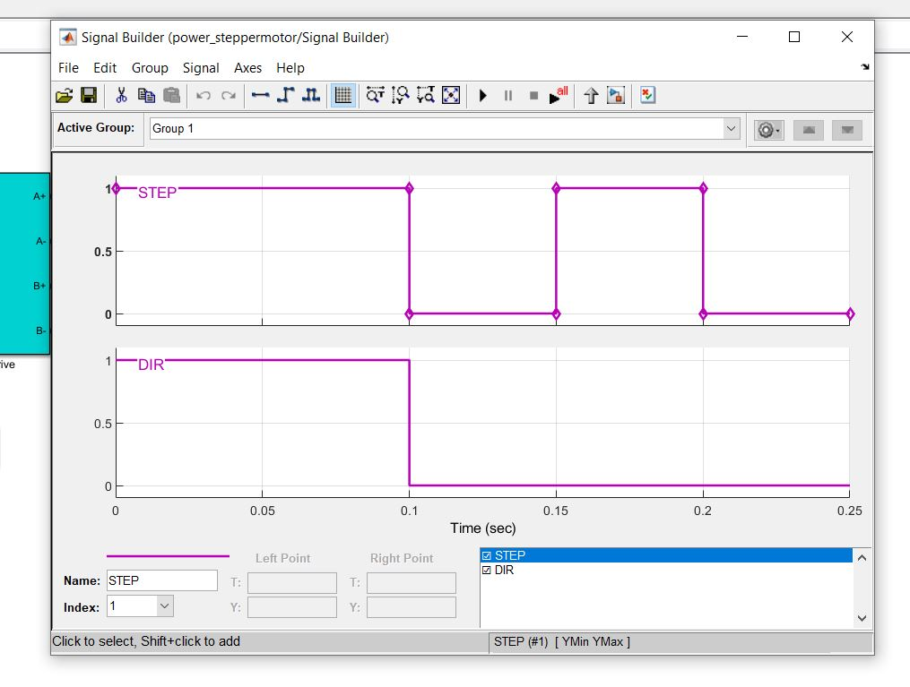
SIMULATION- STEPPER MOTOR

Slide 22
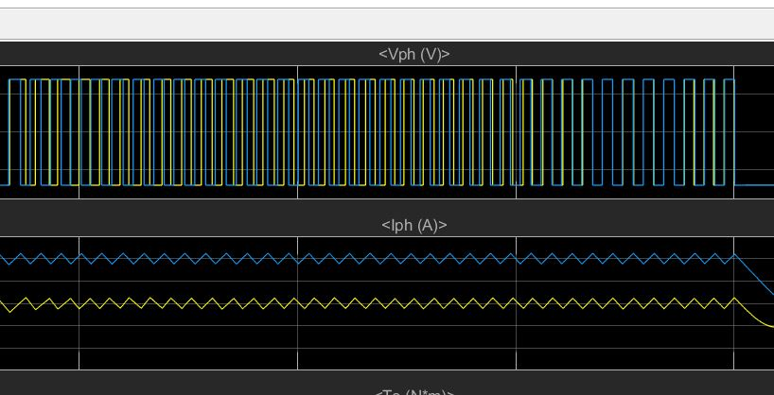
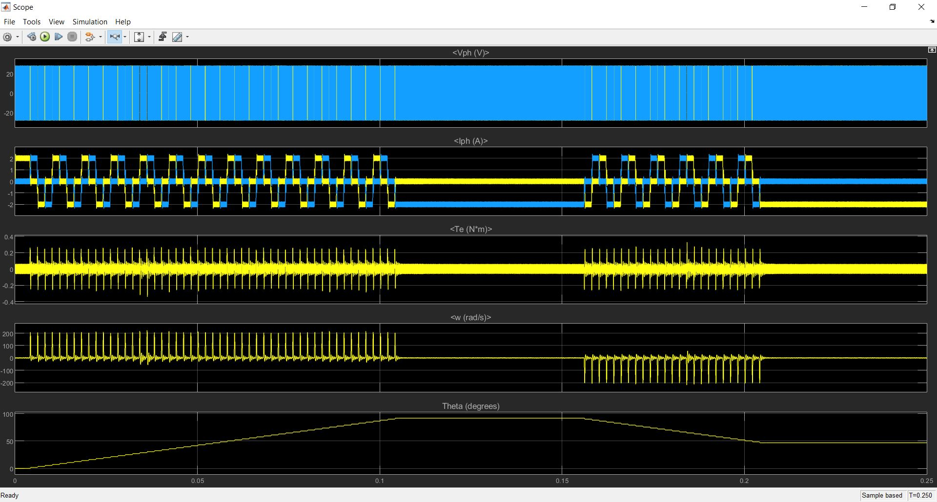
SIMULATION- STEPPER MOTOR

Slide 23
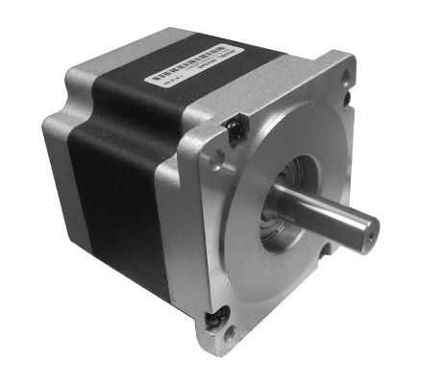
PRACTICAL IMPLEMENTATION
Motor-NEMA 34(Stepper motor)
Step angle-1.8 deg
5A per phase
4.2V operating voltage
8.7Nm Torque

Slide 24
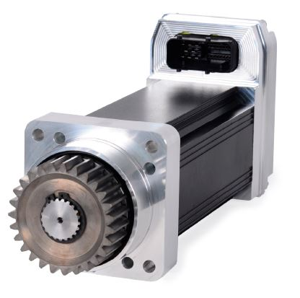

PRACTICAL IMPLEMENTATION
Motor-EPS-07024C10
24V DC
Torque 125Nm(Peak 170Nm)
<100 rpm
Built in sensors to locate the position of turning wheel
Other motors satisfying torque criteria can be used

Slide 25
PRACTICAL IMPLEMENTATION
MICROCONTROLLERS(Popularly used)
Infineon Tri-Core
Atmel-AVR
Renesas Microcontroller

Slide 26
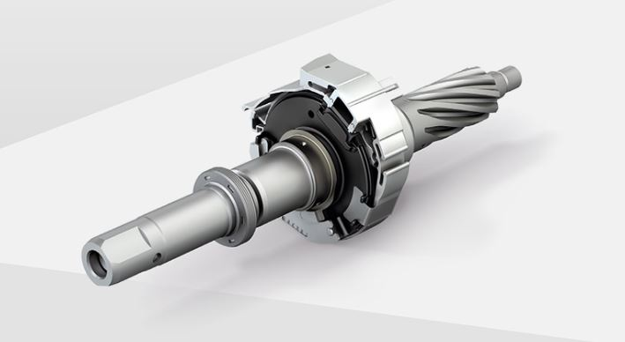
PRACTICAL IMPLEMENTATION
Torque and Angle sensor-Bosch
Hall effect mechanism
Resolution 0.01 deg
Torque and position

Slide 27
Cost of components
Motor- Rs.6000 (NEMA 34)
Microcontroller- less than Rs.5000 Sensors-Rs.1000 to Rs.7000
TOTAL= Rs.12000 to Rs.18000

Slide 28
Testing
motor and its life
optimal sensitivity of steering at different speeds
Parking Mode: where sensitivity is increased

Slide 29
Maintenance
Periodic checking of Motor and other components
Backup steering shaft in case of breakdown
(using clutch)

Slide 30
THANK YOU

